Slide 1





Information Systems
(INS-111)
Computer Networks and Internet
Presented By:
Michael R Chinguwo
Computing and Information Technology Department
The Polytechnic
:265 (0) 993 195 721 :chinguwom@gmail.com

Slide 2
Introduction
Computer network is comprised of at least two, connected, by wire or wireless, computers that can exchange data i.e. communicate.
Reasons for connecting computers Include:
Exchange of data between users that have network access
Access to shared devices, such as network printers, network disks
Enables user communication and socializing
Centralized Administration:- One administrator can control data, devices and permissions of users on the network.

Slide 3
Categories of Computer Networks
Different types of networks are given different descriptive names.
A computer network is identified by the following specific characteristics:
The area it serves
How data is stored
How the resources are managed
How the network is organized
The type of network devices used
The type of media used to connect the devices.

Slide 4
Categories of Computer Networks (Cont’d)
Networks can be categorized based on many factors. Some of factors used to categorize networks include:
Coverage Area:- Personal Area Networks, Local Area Networks, Metropolitan Area Network, Wide Area Network.
Transmission Media Used:- Cable/Wire or Wireless Networks
Architecture:- Client-Server or Peer to Peer
Topology:- Bus, Ring, Star, Mesh, Tree and Hybrid Topology
Transmission Technology used:- Broadcast networks or Point-to Point networks

Slide 5
Types of Computer Networks
Local Area Network (LAN)
A network that connects nearby computers; e.g., a home or office network. Computers on the network can share resources, as well as devices connected to the network.
It covers a relatively small geographical area- it connects computers within a firm or household by wire or wireless technologies.
2. Wide Area Network (WAN)
A network that covers a relatively large geographical area - it connects a greater number of computers and local networks.
Connects together remote computers through dedicated communications channels or the Internet

Slide 6
Types of Computer Networks (Cont’d)
3. Wireless Local Area Network (WLAN)
This is Local Area Network that uses wireless devices to transmit and receive data using radio waves.
On WLAN you can share resources such as:
Files,
Printers
Access to internet.

Slide 7
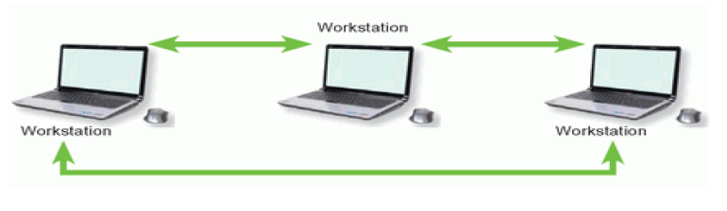
Types of Computer Networks (Cont’d)
4. Peer to Peer Network (P2P)
All computers are clients and servers at the same time
All computers can share responsibility of Processing, storage, printing and communication tasks

Slide 8
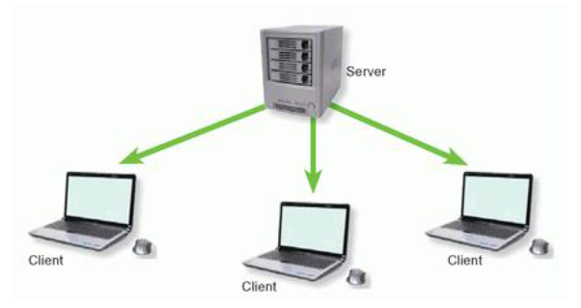
Types of Computer Networks (Cont’d)
5. Client-Server Network
A computer network model where data resources and software are located on special high-performance computers called servers.
Service requesters, referred to as clients, connect to the server through the network and use these resources.

Slide 9
Elements of a network
Rules (protocols)
Protocols that govern how messages are sent, directed, received and interpreted.
Packets(messages)
Electronic messages are sent as packets. Units of information travelling from one device to another.
Medium
Means of interconnecting network devices. A medium transports the messages from one device to another

Slide 10
Elements of a network (Cont’d)
Devices ( host and nodes)
Devices on the network exchange messages with each other

Slide 11
Basic Network Components
There are many components that can be part of a network.
For example PCs, Servers, Networking Devices and Cabling.
These components can be grouped into four main categories:
Hosts
Shared Peripherals
Networking Devices
Networking Media
Hosts
Devices that send and receive messages directly across the network
Examples are: - PCs, Server, Laptop, Network Printer

Slide 12
Basic Network Components (Cont’d)
ii. Shared Peripherals
Devices that are connected to hosts, not directly connected to the network.
Examples are Printer, Scanner, Webcam
iii. Networking Devices
Used to interconnect hosts
Examples are Hub, Switch, Router etc.
iv. Networking Media
Used to interconnect hosts
Examples are cables.

Slide 13
Basic Network Components (Cont’d)
Note:
Some devices can play more than one role, depending on how they are connected.
For Example
A printer directly connected to a host (local printer) is a peripheral.
A printer directly connected to a network device and participates directly in network communications is a hosts
The physical components of a network are needed to move data between devices. The common media used on networks include:
Cables (Twisted pair and Fiber Optic)
Radio Waves

Slide 14
Network Devices
Devices which are used to send data between devices. Some of them include:
Repeater
Is a network device that is used to retransmit the weaker signals in a network.
Used to amplify the signals in the big network.
Hubs
Devices that is used to extend the range of a network by receiving data on one port and then regenerate the data and sending it to all other ports.
They serve as central connection point for LAN, hence also called concentrators
Used to connect two segments of wired network.

Slide 15
Network Devices (Cont’d)
iii. Bridges
Device used to filter network traffic between LAN segments.
It keeps record of all the devices on each segment to which the bridge is connected.
A typical bridge may have just two points, linking two segments of the same network
iv. Switches
Sometimes called multi-port bridges because it has several ports depending on how many network segments are to be linked
Is used to forward packets within a network by using MAC addresses

Slide 16
Network Devices (Cont’d)
v. Routers
Devices that connect entire networks to each other.
It uses IP addresses to forward packets to other networks.
Used in WAN to connect LANs that are separated by great distances.
vi. LAN Card
Network Interface Card (NIC) is used to join the computers in a network.
A NIC is installed in PCI port inside the computer.
A Unique Media Control Access (MAC) address is assigned to LAN Card.

Slide 17
Network Devices (Cont’d)
viii. Gateway
Can be hardware or software and it acts as a bridge between two networks.
It is an entrance point of a network.
It connects a LAN with Internet.
A router acts as a gateway device in a network.

Slide 18
Network Topologies
A network Topology is the physical layout of computers, cables and other components on a network
There are a number of different network topologies, and a network may be built using multiple topologies.
The different types of network layouts are.
Bus Topology
This topology uses one cable as a main trunk to connect devices together.
Is very easy to set up and requires no additional hardware such as hub
The cable is called a trunk, a backbone or a segment

Slide 19
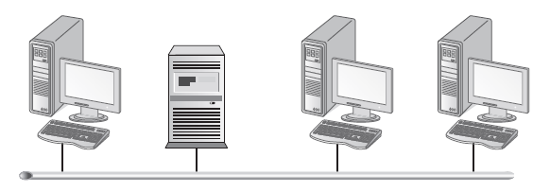
Network Topologies (Cont’d)
Advantages of Bus Topology
It is cheaper:- it uses less cable than star or mesh topology and no need for additional device like hubs.
It is easy to install:- simply connect the workstation to the cable segment or backbone.
If a computer fails, the network stays functional

Slide 20
Network Topologies (Cont’d)
Disadvantages of Bus Topology
Difficult to troubleshoot, due to break in cable segments, this problem can b tough to isolate in large network.
Is not scalable:-its not easy to make changes within the size and layout of bus topology.

Slide 21
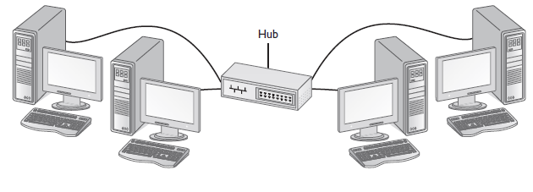
Network Topologies (Cont’d)
2. Star Topology
All computers are connected through one central device known as a hub or a switch.
Breaks in the cable causes only the workstation that is connected to the cable to go down, not the entire network as with bus topology.

Slide 22
Network Topologies (Cont’d)
Advantages of Star Topology
Scalability and ease of adding another system to the network, simply connect the system to an unused port on the hub.
Break in the cable, affects only the system that is connected to that cable.
It is easy to add or change configurations because all of the connections come to a central point.
Disadvantages of Star Topology
If Central Device (Hub) fails, the entire network comes down, but this is much easier to find than finding cable break in bus topology.
It is costly:-to connect workstation, there is a need of a hub with an available port and a cable from the workstation to the hub.

Slide 23
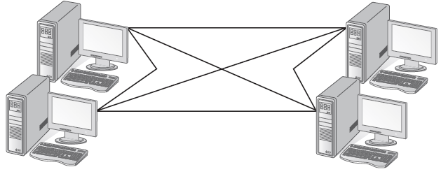
Network Topologies (Cont’d)
3. Mesh Topology
In Mesh Topology, every workstation has a connection to every other component of the network.

Slide 24
Network Topologies (Cont’d)
Advantages of Mesh Topology
It is fault tolerance:-when there is a break in a cable segment, traffic can be routed through a different pathway because there are multiple pathways to send data from one system to another.
Disadvantages of Mesh Topology
It is costly:- there is a need of additional cabling and network interfaces to create the multiple pathways between each system.
It is very hard to administer and manage because of numerous connections.

Slide 25
Network Topologies (Cont’d)
4. Ring Topology
All computers are connected via a cable that loops in a ring or circle.
The circle has no start and no end, hence terminators are not necessary in a ring topology.
Signals travel in one direction on a ring while they are passed from one computer to the next.
Each computer regenerate the signal so that it may travel the distance required.

Slide 26
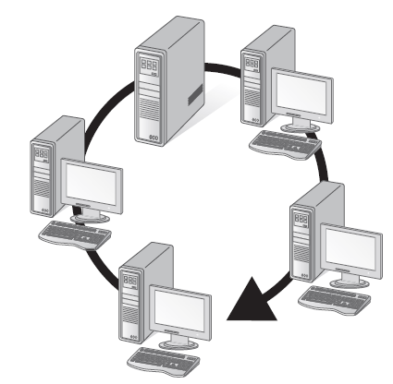
Network Topologies (Cont’d)
Advantages of Ring Topology
Signal Degeneration is low because each workstation is responsible for generating or boosting the signals. Hence strong signal when reaching its destination and seldom needs to be retransmitted.

Slide 27
Network Topologies (Cont’d)
Disadvantages of Ring Topology
If one computer fails or the cable link is broken, the entire network could go down.
Isolating a problem can be difficult in some ring configurations.
Brief disconnection can interrupt or bring down the entire network i.e. making cabling change to the network or move a workstation.

Slide 28
Network Topologies (Cont’d)
5. Hybrid Topology
This is mixture of topologies to form a hybrid topology
For example, a star-bus topology, a number of star topologies connected by a central bus. This is popular topology because the bus will connect hubs that are spread over distance.
Another popular hybrid topology is the star-ring topology. It looks as a star but acts as a ring.

Slide 29
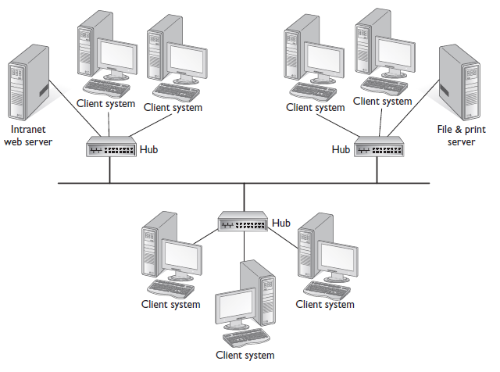
Network Topologies (Cont’d)
Star-bus Topology

Slide 30
Internet
Background
Begun in 1957 when Soviet Union Launched Sputnik.
In 1969 ARPANET (Advanced Research Projects Agency) connected Computers at UCLA, Stanford Research Institute.
In 1985, National Science Foundation (NSF) used ARPANET Technology to create a larger Network, Connecting entire LANs to each other.
The NSF network was internet, as this network grew throughout the world, it became Internet.

Slide 31
Internet Infrastructure
Internet is not owned or operated by any single organisation or government. It is network connected to other networks and to the internet backbone.
Internet Backbone
Is a network of high-capacity communications links that provides the main routes for data traffic across the internet.
Network Service Providers (NSPs)
NSP Maintain internet backbone links and routes.
NSP Equipment and links are tied together by Network Access Points (NAPs) to transfer data from source to destination.

Slide 32
Internet Infrastructure (Cont’d)
Internet Service Provide (ISP)
Is a company that offers Internet access to individuals, businesses, and smaller ISPs.

Slide 33
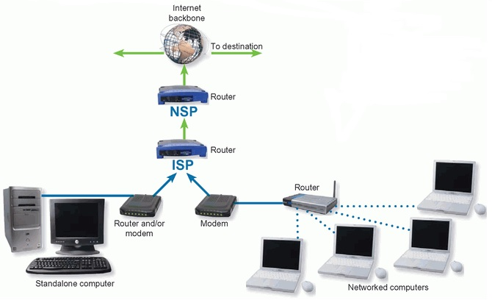
Internet Infrastructure (Cont’d)

Slide 34
Internet Protocols
Rules that govern communication on the Internet.
The Internet uses a variety of communications protocols to support basic data transport and services, such as e-mail, web access and downloading.
Some of the Main Protocols used on the Internet include:
Transmission Control Protocol (TCP)
Creates connections and exchange packets of data
2. Internet Protocol (IP)
Provides devices with unique addresses

Slide 35
Internet Protocols (Cont’d)
3. User Datagram Protocol (UDP)
Alternative to TCP used for DNS, VoIP and File Sharing
4. Hypertext Transfer Protocol (HTTP)
Exchanges information over the web
5. File Transfer protocol(FTP)
Transfers files between local and remote host computers

Slide 36
Internet Protocols (Cont’d)
6. Post Office Protocol (POP)
Transfers mail from an e-mail server to client Inbox
7.Simple Mail Transfer Protocol (SMTP)
Transfers e-mail messages from client computers to an e-mail server.
8. Voice over Internet Protocol (VoIP)
Transmits voice conversations over the Internet
9. Internet Relay Chat (IRC)
Transmits text messages in real time between online users.

Slide 37
Protocol Suite
Is a combination of protocols that work together, example TCP/IP.
TCP Breaks a message or file into packets. IP is responsible for addressing the packets so that they can be routed to their destination.
TCP/IP provides a protocol standard for the internet that is public, free, extensible and easy to implement.

Slide 38
Data Transfer
Downloading
Receiving/taking a copy of digital data from a network computer to a local computer ; e.g., downloading a file from the Internet to the computer’s hard drive.
Uploading
Sending of data from the local computer to network computer ; e.g., uploading a video to a specialized server on the Internet.
Bitrate
Represents speed at which data is transferred through network
It is measured in bit/s (bit per second)

Slide 39
Types of Internet Connections
The data transfer rate varies depending on the network technology used and the type of connection to the particular computer or the Internet.
Some of the ways to get connected to Internet include:
i. Dial-up Connection
The modem of computer uses a standard telephone line to connect to the Internet. A dial-up connection is a slow-speed technology.
ii. Digital Subscriber Line (DSL)
Is a technology that provides high speed Internet connections using regular telephone lines

Slide 40
Types of Internet Connections (Cont’d)
iii. Mobile Internet
Access to the Internet is provided by a mobile communications network
Connecting by using a mobile network (GPRS, EDGE, UMTS, HSPA)
iv. Satellite
Satellite Modem communicates with a satellite dish to provide high-speed Internet connections via satellite.
v. Wireless (Wi-Fi)
Data is transferred between computers by using radio frequencies and the corresponding antennas

Slide 41
Types of Internet Connections (Cont’d)
vi. Cable
A cable Modem allows access to high speed Internet services through the cable television network.
vii. Fiber-optic connection
Uses optical fibers instead of metal wires, and transmits pulses of light rather than electrical signals.
viii. Broadband
Broadband is characterized by a high-speed data transfer, permanent access to the Internet, and thus the risk of unauthorized access to the network or your personal computer.

Slide 42
Intranet and Extranet
Intranet
Typically a computer network used by a single organization, in which resources are shared by using Internet technologies
An organizations internal private network that uses the infrastructure and standards of the internet and the web.
Extranet
An intranet with limited access from the outside. Access is usually granted to trusted and authorized users.
Are private intranets that connect not only internal personnel but also other strategic parties

Slide 43
The World Wide Web (W3)
Is a system for accessing documents supported by the internet. The W3 is a collection of information often accessed by navigation through a graphical user interface.
Web documents can be linked together because they are created in a format known as Hypertext. Hypertext systems provide an easy way to manage large collections of data, which can include text files, pictures, etc.
To support hypertext documents, the web uses HTTP Protocol
Hypertext document is encoded file that uses Hypertext Markup Language (HTML)

Slide 44
The World Wide Web (W3)
HTML allows to embed hypertext links (Links) in the document.
Hypertext document is called a Web page. By clicking a word, or a picture encoded as a hypertext link, you are directed to another location within the same document or to a different Web page.
A collection or related Web pages is called a Web Site
A website is housed on a web server, which is a computer that delivers requested Web pages to client computer
Web Publishing
Is the development and maintenance of Website

Slide 45
The World Wide Web (W3)
Web Browser
Is a software application that allows users to access and view Web Pages.
To browse the Web you need a computer that is connected to the Internet and that has a Web Browser.
Examples of Web Browsers include:- Google Chrome, Internet Explorer, Netscape, Mozilla Firefox, Opera, Safari.
Navigating the Web
This is moving from one web page to another or from one website to another. URLs (Uniform Resource Locator) are the key to navigating the web.

Slide 46
END

